Slide 1
أكـــــاديميــــة طــــويـــق
Deep Learning

Slide 2
Fundamentals of Deep Learning
Basic concepts
By: Dr. Afshan Hashmi

Slide 3
Course Objectives:
Understand the foundational concepts of Deep Learning and how it differs from traditional Machine Learning techniques.
Identify and explain key components of neural networks, including activation functions, loss functions, and optimizers.
Compare various real-world applications of Deep Learning across domains such as healthcare, finance, and NLP.
Analyze the advantages and limitations of Deep Learning models in terms of data, computation, and interpretability.
Explore ongoing research and emerging areas in Deep Learning, such as federated learning and neuromorphic computing.

Slide 4
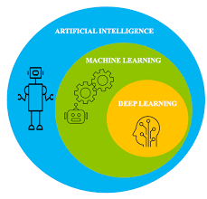
Introduction to Deep Learning
Deep Learning (DL) is a specialized branch within Machine Learning (ML).
It focuses on using Artificial Neural Networks (ANNs) mathematical models designed to simulate how the human brain processes information.
Just like the brain has neurons connected to each other, ANNs have nodes (artificial neurons) and layers through which data passes and gets transformed.
Deep Learning models are called "deep" because they contain many layers hence the term "deep" neural networks.

Slide 5
Introduction to Deep Learning
Deep Learning is a subfield of Machine Learning (ML) that uses algorithms known as Artificial Neural Networks (ANNs), which are inspired by the structure and function of the human brain
What is Deep Learning?
A subset of machine learning inspired by the structure of the human brain
Uses artificial neural networks with multiple layers ("deep" architectures)
Capable of automatic feature extraction from raw data
Why Deep Learning ?
Traditional ML | Deep Learning
Requires manual feature engineering | Learns features automatically
Performance plateaus with more data | Improves with more data & compute
Limited to structured data | Works with images, text, audio, etc.

Slide 6
Introduction to Deep Learning
Why it's important:
These deep architectures allow DL models to learn very complex patterns in data.
That's why Deep Learning powers applications like image recognition, voice assistants, self-driving cars, and language translation.
Advantages over traditional ML:
No need for manual feature engineering.
Performance improves with more data and compute.
Effective on unstructured data like images, text, and audio.
Historical Milestones
1958: Perceptron (Frank Rosenblatt)
1986: Backpropagation (Rumelhart & Hinton)
2012: AlexNet revolutionizes computer vision
2020s: Transformer models (GPT, BERT) dominate NLP

Slide 7
Difference Between Machine Learning and Deep Learning
Feature | Machine Learning | Deep Learning
Data Dependency | Works well on small datasets | Requires large amounts of data
Feature Engineering | Manual feature extraction | Learns features automatically
Algorithms | SVM, Decision Trees, Random Forest | CNN, RNN, LSTM, Transformers
Interpretability | Easier to interpret | Often considered a "black box"
Training Time | Shorter | Longer, computationally expensive
Hardware Dependency | Can run on CPU | Requires GPUs/TPUs for training

Slide 8
Core Concepts in Deep Learning
1. Neural Networks
A neural network is made up of layers of neurons (nodes).
Each layer transforms the input data and passes it to the next layer.
Input Layer: Accepts raw data.
Hidden Layers: Perform computations and transformations.
Output Layer: Gives the final prediction or classification.
2. Activation Functions
These introduce non-linearity, allowing the model to learn complex patterns:
ReLU (Rectified Linear Unit): Most common; turns negative values to 0.
Sigmoid: Outputs values between 0 and 1; useful for binary classification.
Tanh: Similar to sigmoid but outputs between -1 and 1.
Softmax: Converts outputs into probabilities (used for multi-class classification).

Slide 9
Core Concepts in Deep Learning
3. Forward Propagation & Backpropagation
Forward Propagation: Data passes through the network from input to output.
Backpropagation: The model adjusts weights by calculating the gradient of the loss function with respect to each weight (via chain rule).
This helps the model learn from its mistakes.
4. Loss Functions
Measures the difference between predicted and actual output:
MSE (Mean Squared Error): Used in regression tasks.
Cross-Entropy Loss: Common in classification tasks.

Slide 10
Core Concepts in Deep Learning
5. Optimizers: Algorithms that adjust the weights to minimize the loss:
SGD (Stochastic Gradient Descent): Basic optimizer, updates weights with small batches.
Adam (Adaptive Moment Estimation): More advanced; adjusts learning rate dynamically for better convergence.
6. Epochs and Batches: Training in batches improves efficiency and generalization.
Epoch: One full pass through the training dataset.
Batch: A subset of data used to train the model in one forward/backward pass.
7. Regularization Techniques: Help prevent overfitting (where the model memorizes rather than learns):
Dropout: Randomly turns off neurons during training.
L2 Regularization: Penalizes large weights by adding their squared values to the loss.

Slide 11
Common Architectures
Architecture | Purpose | Example
Feedforward NN | Basic classification/regression | MNIST digit recognition
CNN (Convolutional NN) | Image/video processing | ResNet, VGG
RNN/LSTM | Sequential data (text, time series) | Language translation
Transformer | NLP tasks | GPT, BERT

Slide 12
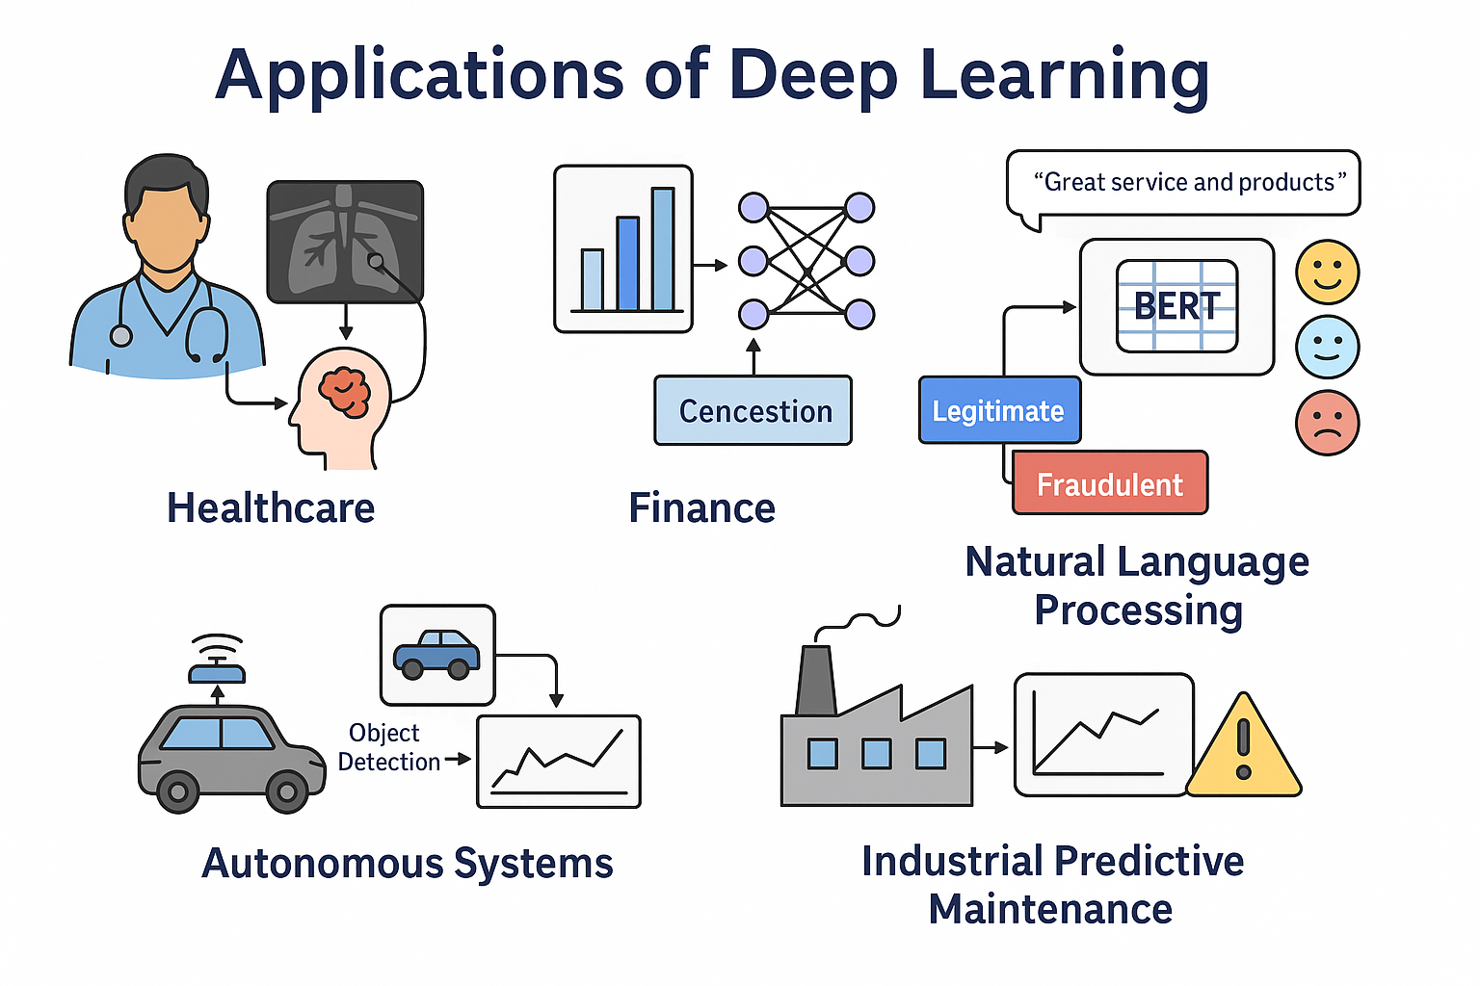
Application of Deep Learning
Problem: Identify early signs of disease from medical imaging to improve diagnostic accuracy and treatment outcomes.
Solution: Leverage deep learning models, such as Convolutional Neural Networks (CNNs), trained on large datasets of labeled medical images (e.g., X-rays, MRIs, CT scans). The model classifies the presence and severity of conditions (e.g., normal, mild, moderate, severe).
Impact:
Automates diagnostic workflows, improving efficiency for healthcare professionals.
Enhances accessibility to diagnostic services in underserved or remote areas.
Enables early intervention, reducing disease progression and improving patient outcomes.

Slide 13
Application of Deep Learning
Finance Case Study: Fraud Detection in Credit Card Transactions
Problem: Real-time detection of fraudulent credit card usage.
Solution:
Use Autoencoders or LSTM models to detect anomalies in time-series transaction data.
Trained on "normal" behavior, model flags unusual patterns.
Impact:
Saves millions in losses for financial institutions.
Improves customer trust.

Slide 14
Application of Deep Learning
NLP Case Study: Chatbots for Customer Support
Problem: Automate responses to FAQs and service issues.
Solution:
Use Transformer-based models (e.g., BERT, GPT) fine-tuned on domain-specific data.
Chatbot understands queries and responds in natural language.
Impact:
Reduces customer wait times.
Works 24/7 and can escalate complex cases to humans.

Slide 15
Application of Deep Learning
Autonomous Systems Case Study: Self-Driving Car
Problem: Safely navigate roads without human input.
Solution:
Cameras + sensors feed real-time data to CNNs for object detection.
Reinforcement Learning used for decision-making and route planning.
Impact:
Reduces human error.
Potential to reshape transportation industry.

Slide 16
Application of Deep Learning
Industrial Case Study: Predictive Maintenance
Problem: Unexpected breakdowns in machinery.
Solution:
Use Time-series Deep Learning (LSTM) on sensor data to predict failures.
Alerts maintenance team before a breakdown.
Impact:
Reduces downtime.
Saves operational costs.

Slide 17
Technical Challenges
Data Hunger: Requires massive labeled datasets
Deep learning models, especially large ones like GPT or image classifiers, need huge amounts of labeled data to perform well. Getting this data can be time-consuming, costly, and sometimes not even possible for niche problems.
Compute Costs: GPU/TPU resources expensive
Training these models often needs powerful hardware like GPUs (Graphics Processing Units) or TPUs (Tensor Processing Units). These resources are expensive, making AI development costly, especially for small organizations or researchers.
Black Box Problem: Hard to interpret decisions
Many AI models (especially deep neural networks) are often considered “black boxes”, meaning it's difficult to understand how they make decisions. This lack of transparency can be problematic in sensitive fields like healthcare or law.

Slide 18
Future Trends-Emerging Areas in Deep Learning
Emerging Areas in Deep Learning
Neuromorphic Computing: Brain-Inspired Chips
What it is: A type of hardware designed to mimic the way the human brain processes information using neurons and synapses.
Why it matters: Traditional CPUs and GPUs are power-hungry for deep learning tasks. Neuromorphic chips (like Intel’s Loihi or IBM’s TrueNorth) aim to provide faster and energy-efficient computation.
Applications: Real-time robotics, edge AI, and low-power smart sensors.

Slide 19
Future Trends-Emerging Areas in Deep Learning
2. Federated Learning: Privacy-Preserving Training
What it is: A decentralized machine learning method where the model is trained across multiple devices or servers without transferring raw data.
Why it matters: Protects user privacy by keeping data on-device (e.g., smartphones).
Example: Google's Gboard uses federated learning to improve typing suggestions without accessing your personal messages.
Benefit: Complies with data privacy laws (e.g., GDPR) and ensures data security.

Slide 20
Future Trends-Emerging Areas in Deep Learning
3. Quantum Machine Learning (QML): Hybrid Quantum-Classical Models
What it is: Combines quantum computing with machine learning to process and learn from data using the principles of quantum mechanics.
Why it matters: Quantum computers can solve certain problems much faster than classical computers, especially for optimization or high-dimensional data.
Still experimental: But promising for future breakthroughs in areas like drug discovery and cryptography.

Slide 21
Research Frontiers in Deep Learning
1. Self-Supervised Learning
What it is: A training approach where models learn from unlabeled data by generating pseudo-labels.
Why it matters: Reduces the need for costly manual data labeling and is ideal for large-scale learning.
Example: Contrastive learning in vision (e.g., SimCLR, BYOL) or language models like BERT.
2. Energy-Efficient Models
What it is: Focus on reducing computation and power consumption of deep learning models without sacrificing accuracy.
Techniques: Model pruning, quantization, knowledge distillation.
Why it's critical: Supports sustainable AI and enables deployment on edge devices (e.g., mobile phones, IoT sensors).

Slide 22
Research Frontiers in Deep Learning
3. Multimodal AI (Text + Image + Audio)
What it is: AI systems that can understand and generate content from multiple data types simultaneously.
Example: OpenAI’s GPT-4 (can process both text and images), DALL·E, CLIP, and Google DeepMind’s Flamingo.
Real-World Use: Medical diagnostics (X-rays + doctor notes), social media analysis, interactive assistants.

Slide 23


Summary
Deep Learning is data-hungry but powerful.
It automates feature extraction.
Requires high-performance computing resources.
It's already transforming various industries.
Learning DL involves both theory (math, optimization) and practice (coding models).

Slide 24
Books and References
"Deep Learning" (Ian Goodfellow et al.)
"Neural Networks and Deep Learning" (Michael Nielsen)
Courses
Deep Learning Specialization (Andrew Ng, Coursera)
Fast.ai Practical Deep Learning
Datasets for Practice
MNIST (Handwritten digits)
CIFAR-10 (Image classification)
IMDB Reviews (Sentiment analysis)

Slide 25

















الشراكات العالمية

Slide 26
شــــــكــــرًا لكــــــم
THANK YOU

